Slide 1
Class 01: 機器學習簡介
蕭佳明 遠東科技大學 助理教授
github: https://github.com/yihlonlin/Machine-Learning

Slide 2
機器學習簡介
計畫課程簡介
機器學習簡介
環境建置與安裝
開源的資料集簡介
線上機器學習範例介紹
醫學專題實作

Slide 3
計畫課程簡介

Slide 4
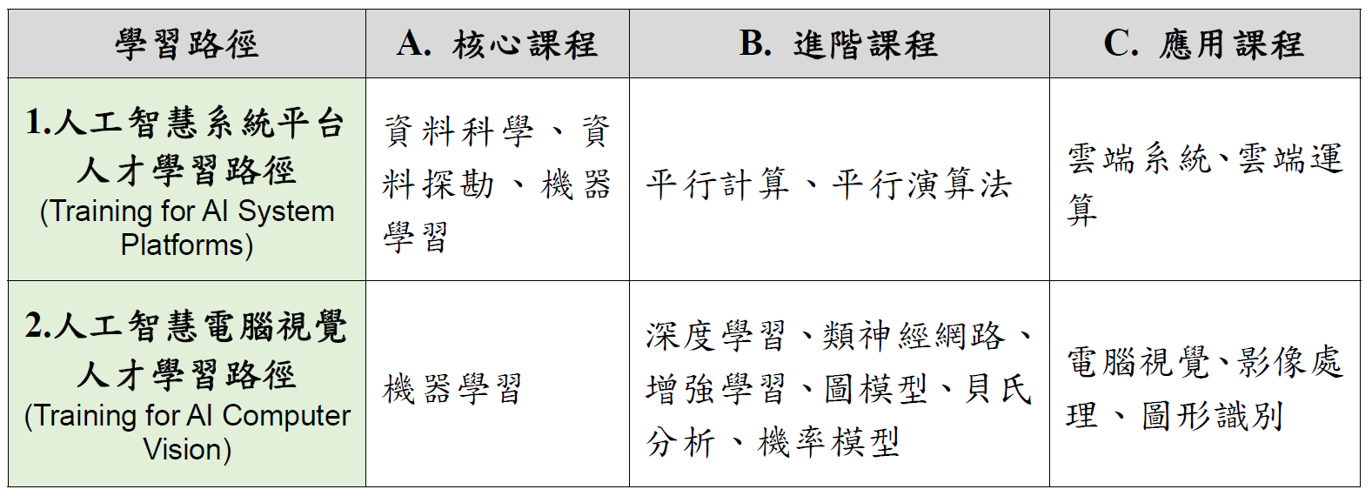
計畫課程簡介

Slide 5
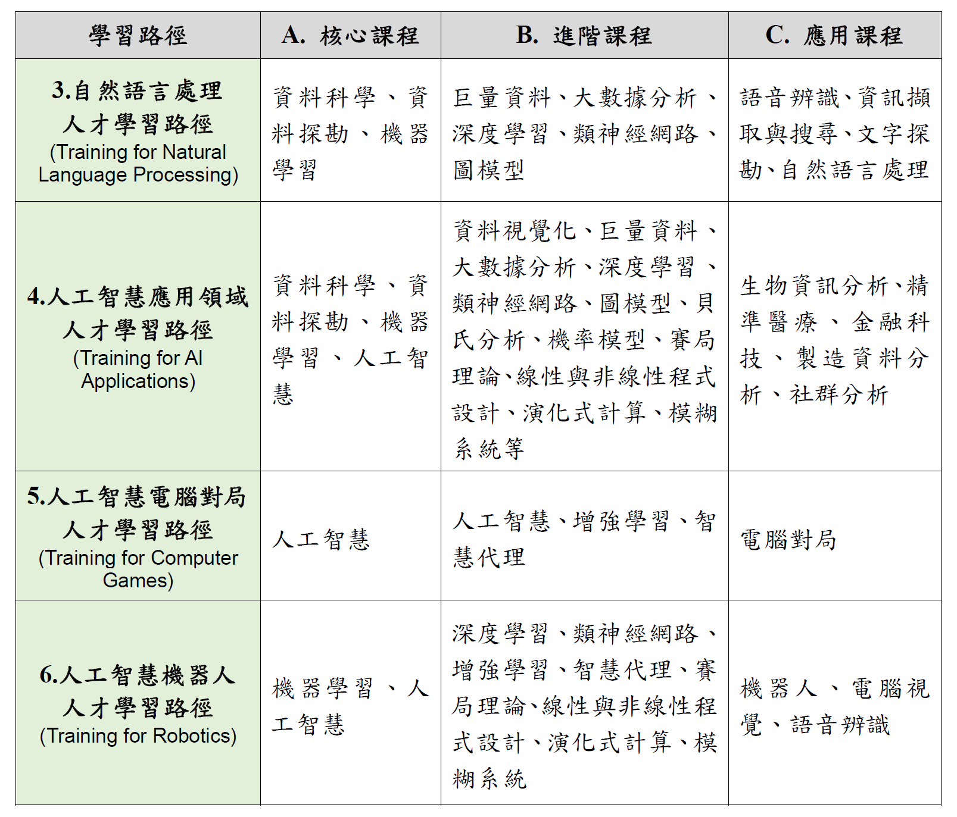
計畫課程簡介

Slide 6
環境建置與安裝

Slide 7
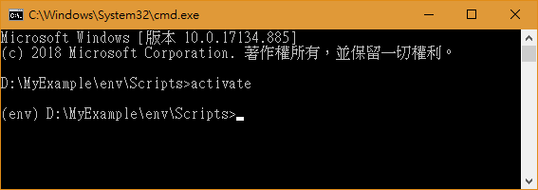
Virtual Environment
C:\Users\user>pip install virtualenv
D:\MyExample>virtualenv env
make env
D:\MyExample>env\Scripts > activate
(env) D:\MyExample>pip install XXX
D:\MyExample>env\Scripts > deactivate

Slide 8
Virtual Environment
D:\MyExample>env\Scripts > activate
(env) D:\MyExample>pip install keras
(env) D:\MyExample>pip install jupyter
(env) D:\MyExample>pip install opencv-contrib-python
(env) D:\MyExample>pip install Sequential
(env) D:\MyExample>pip install utils
(env) D:\MyExample>pip install tensorflow

Slide 9
Virtual Environment
D:\MyExample>env\Scripts > activate
(env) D:\MyExample>pip install imutils
(env) D:\MyExample>pip install dlib==19.6.1
(env) D:\MyExample>pip install mtcnn
(env) D:\MyExample>pip install matplotlib
(env) D:\MyExample>pip install pillow
(env) D:\MyExample>pip install pandas
(env) D:\MyExample>pip install pandas
(env) D:\MyExample>pip install sklearn
(env) D:\MyExample> pip install pydot
pip install requirements.txt
pip freeze > requirements.txt
Notes:
pandas

Slide 10
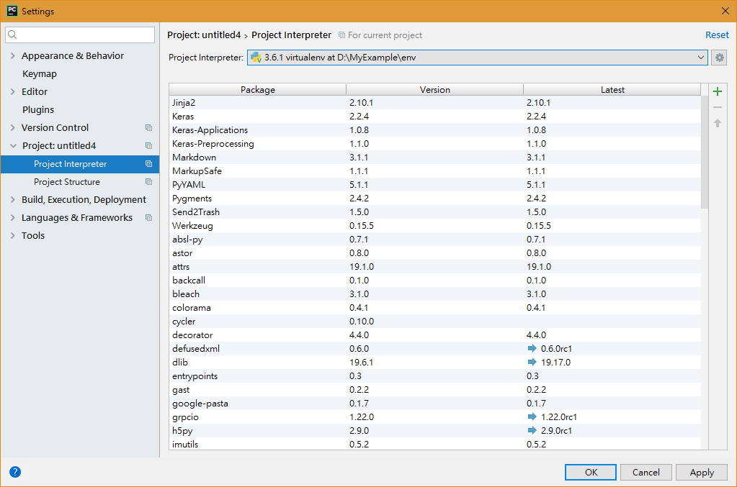
PyCharm

Slide 11
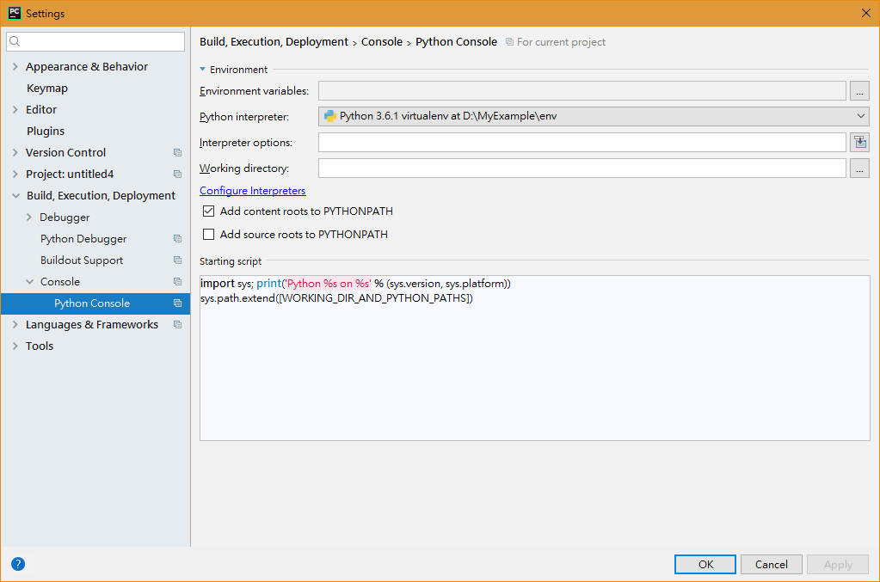
PyCharm

Slide 12
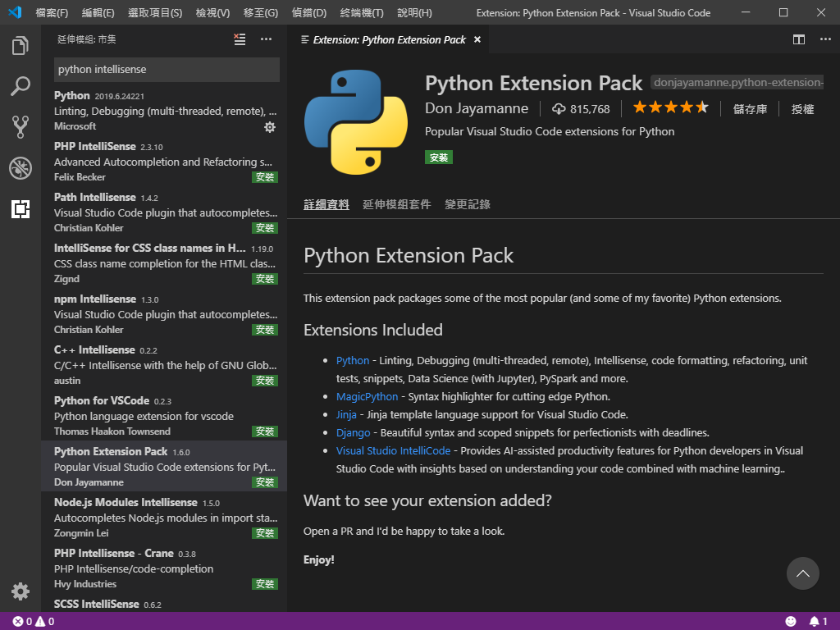
VS Code
Extension Pack
Chinese
Python (Reload)
IntelliSense/Auto-Completion
Linter pylint
Python Extension Pack
http://www.weithenn.org/2018/05/python-journey-part02-how-to-use-vscode.html
Notes:
當 Python extension for Visual Studio Code 安裝完成後，請記得點選「Reload」讓 VS Code 工具能夠讓 Python Extension 功能立即套用生效。

Slide 13
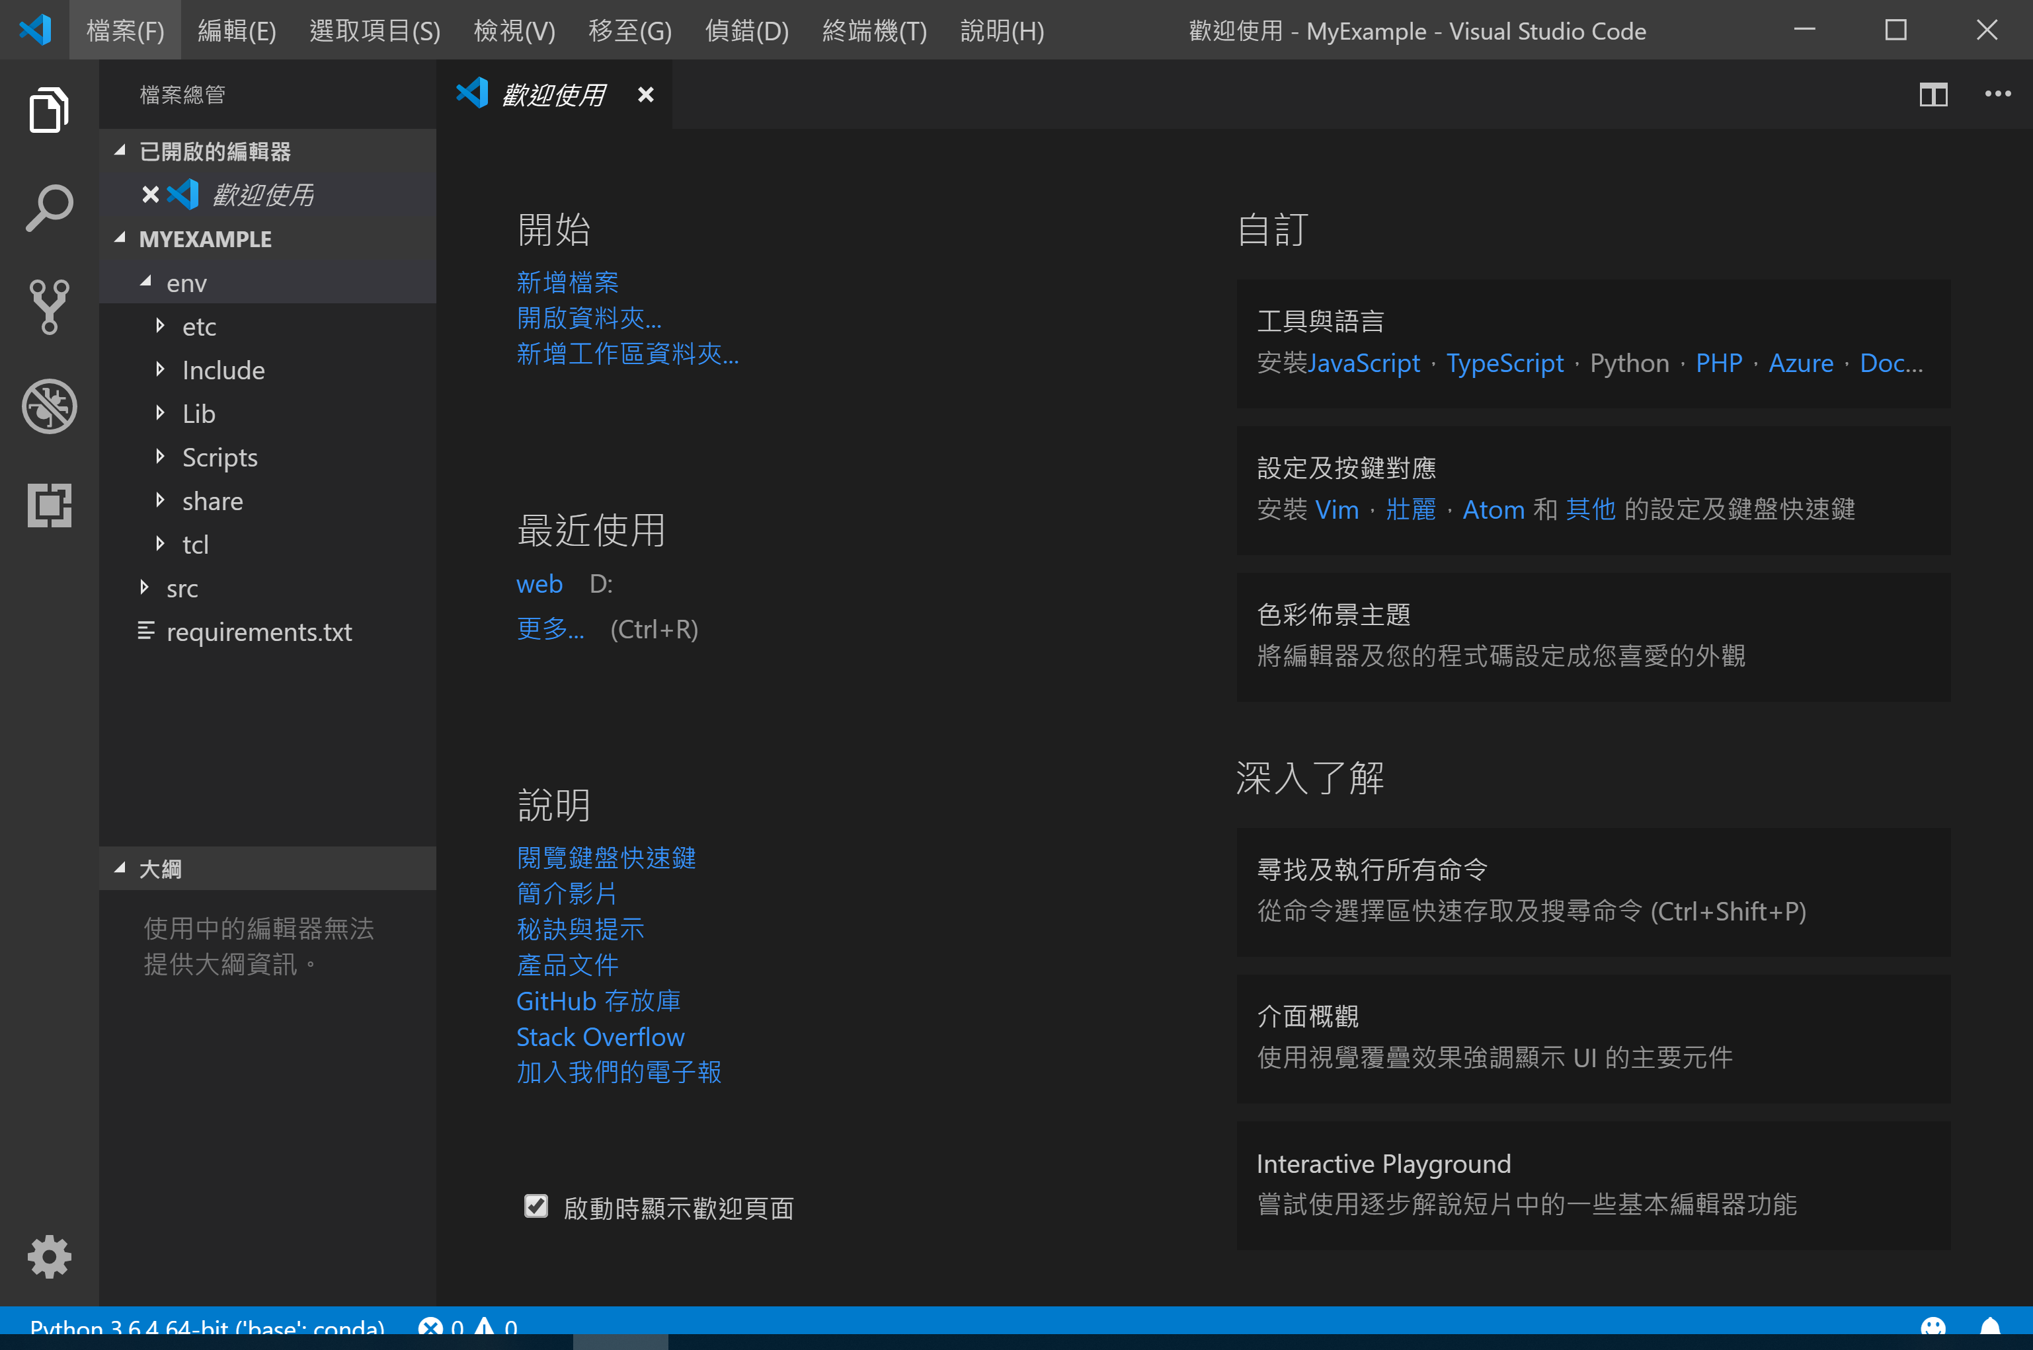
VS Code
Open Folder

Slide 14
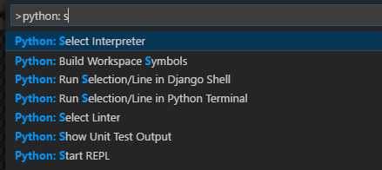
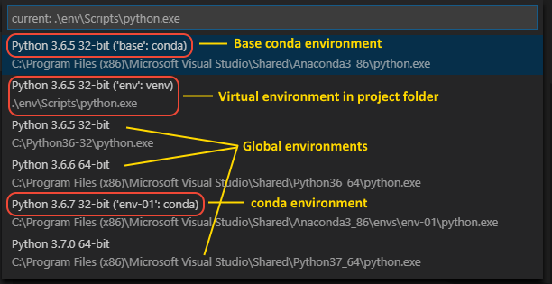
VS Code
Python: Select Interpreter (Ctrl+Shift+P)
Windows size: ctrl+/-

Slide 15
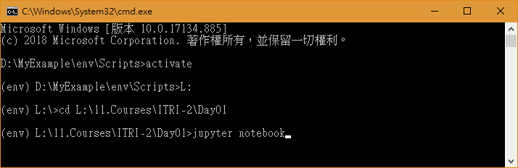
Jupyter Notebook
D:\MyExample\env\Scripts>activate
(env) D:\MyExample\env\Scripts>L:
(env) L:\>cd L:\11.Courses\ITRI-2\Day01
(env) L:\11.Courses\ITRI-2\Day01>jupyter notebook

Slide 16
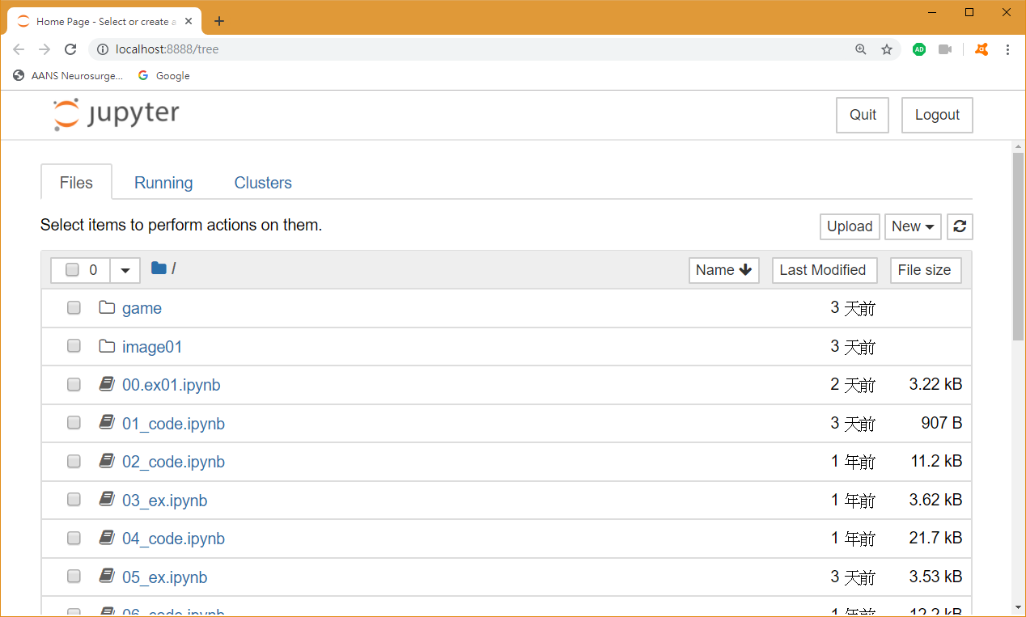
Jupyter Notebook

Slide 17
Google Colaboratory
Google 提供深度學習運行的雲端空間
Colab 如何GPU/TPU設定
Colab 如何掛載雲端空間
Colab 如何載入老師的雲端圖片
如何載入電腦圖片
程式路徑如何設定
時間限制(12 hr)

Slide 18
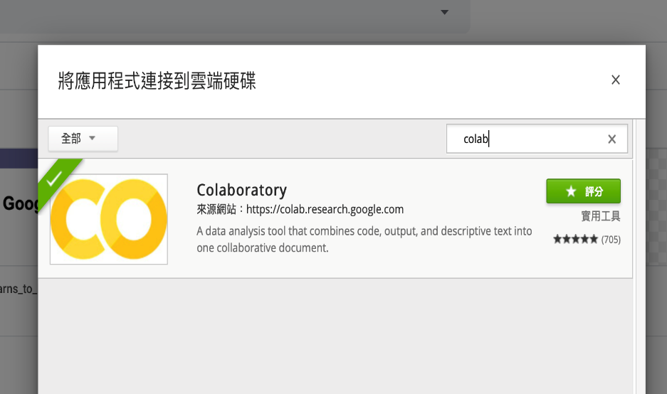
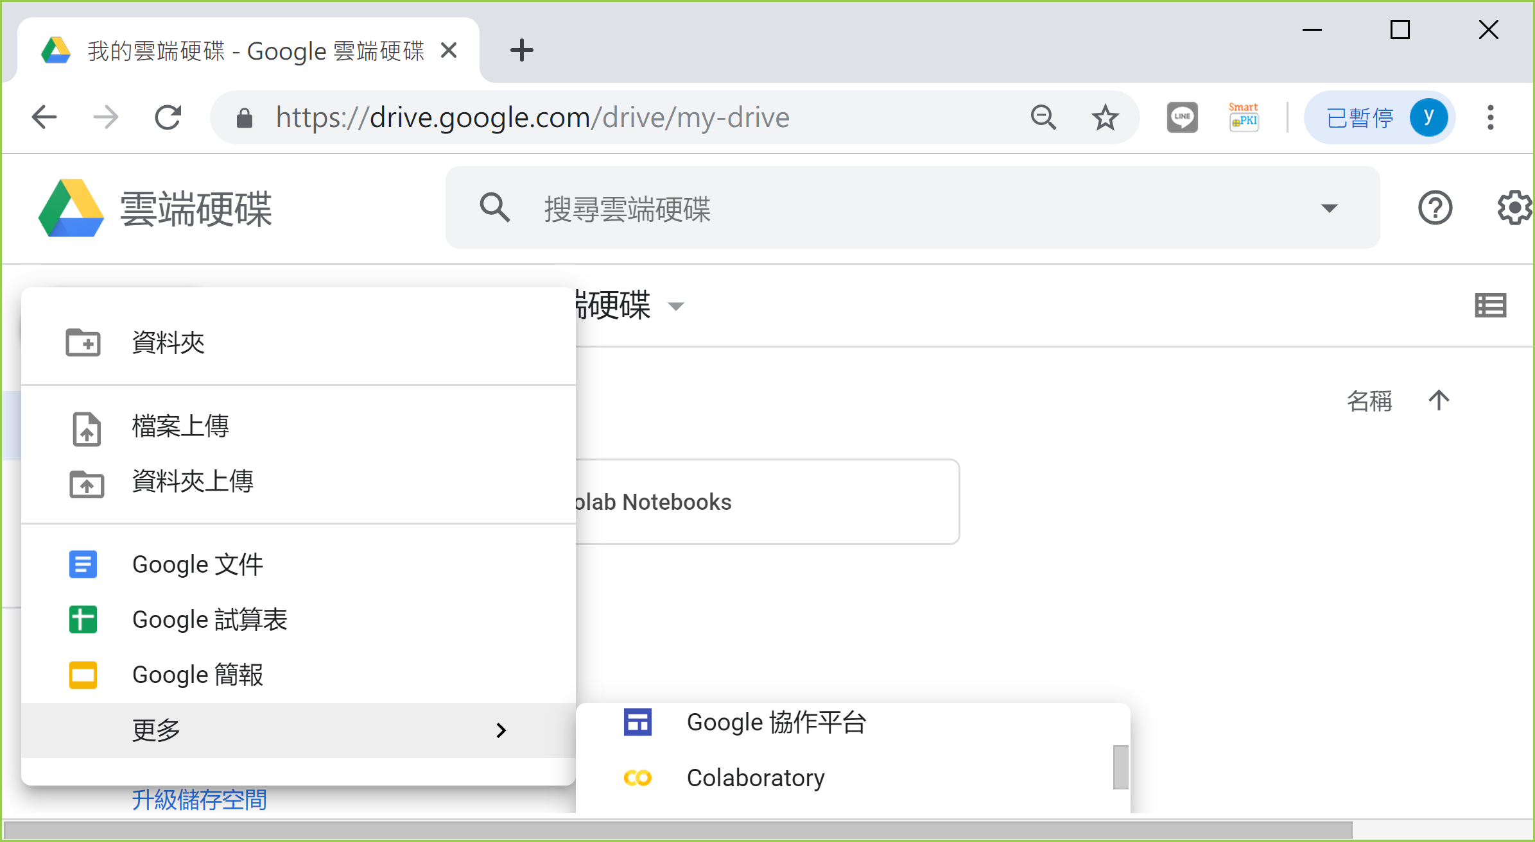
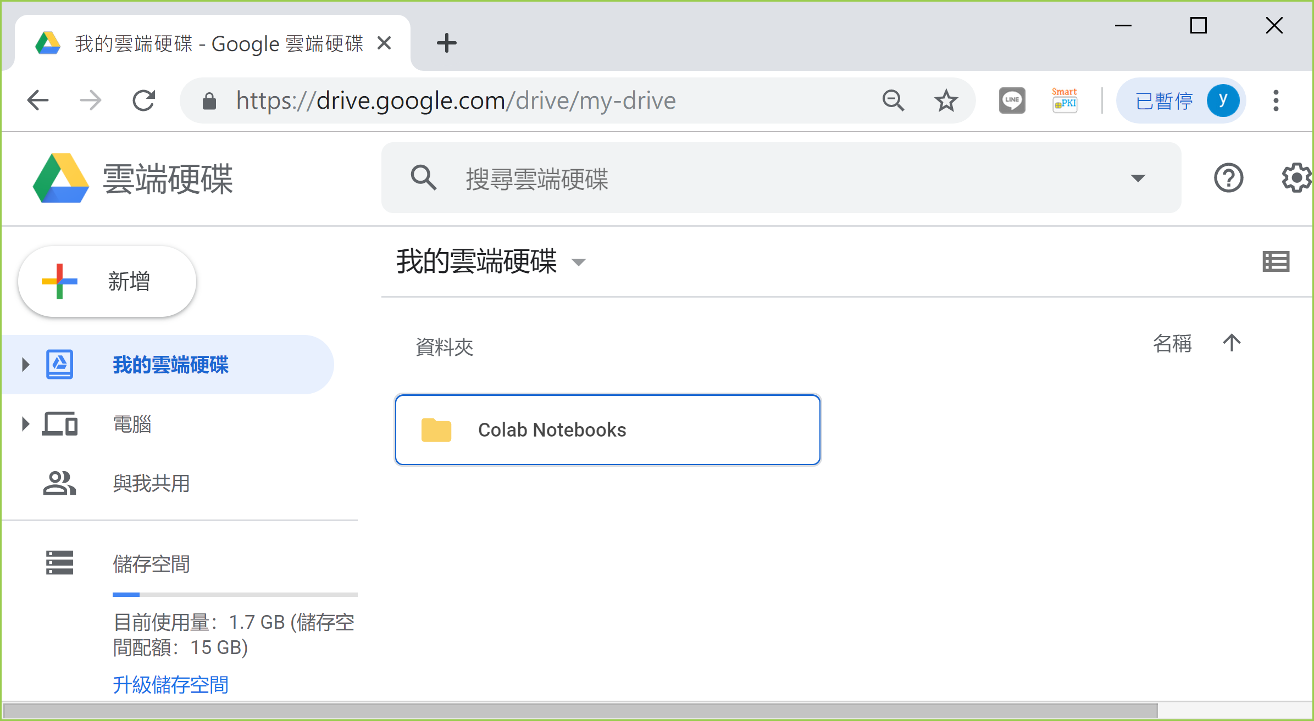
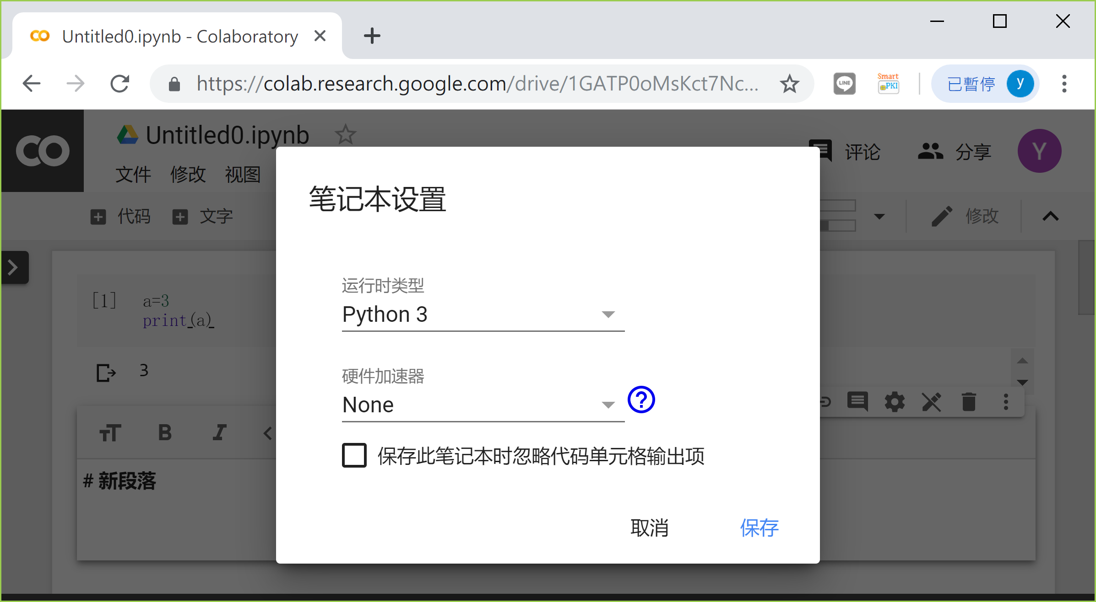
Google Colaboratory
https://zhuanlan.zhihu.com/p/33466657

Slide 19
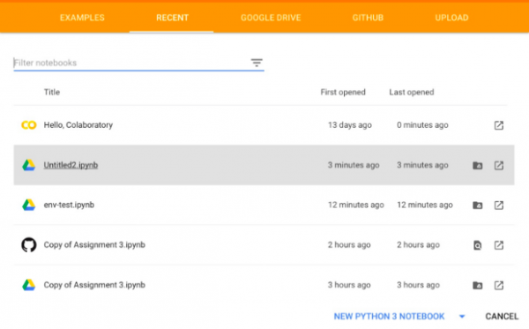
Google Colaboratory
https://colab.research.google.com

Slide 20
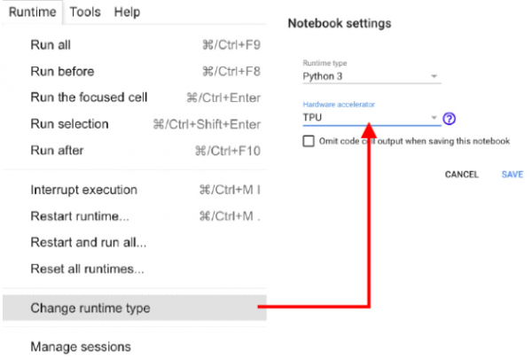
Google Colaboratory
Runtime
https://colab.research.google.com

Slide 21
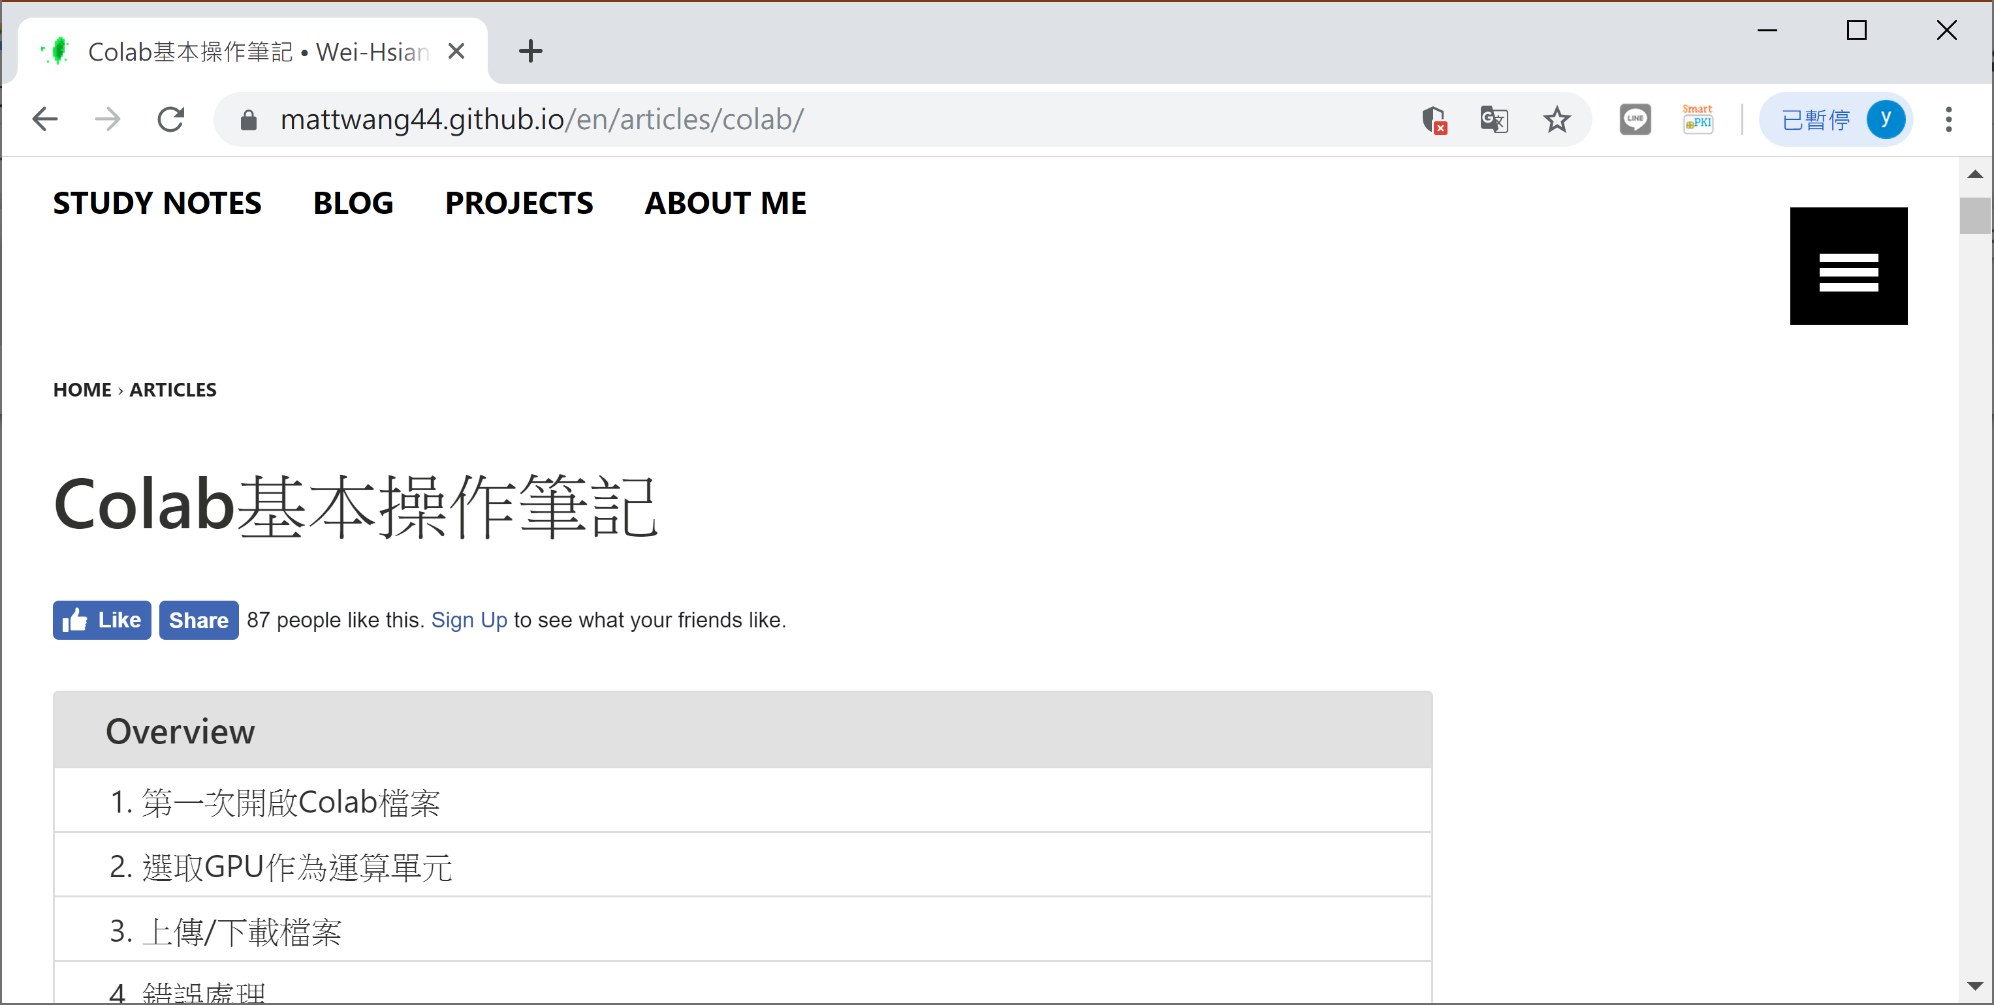
Google Colaboratory
https://mattwang44.github.io/en/articles/colab/

Slide 22
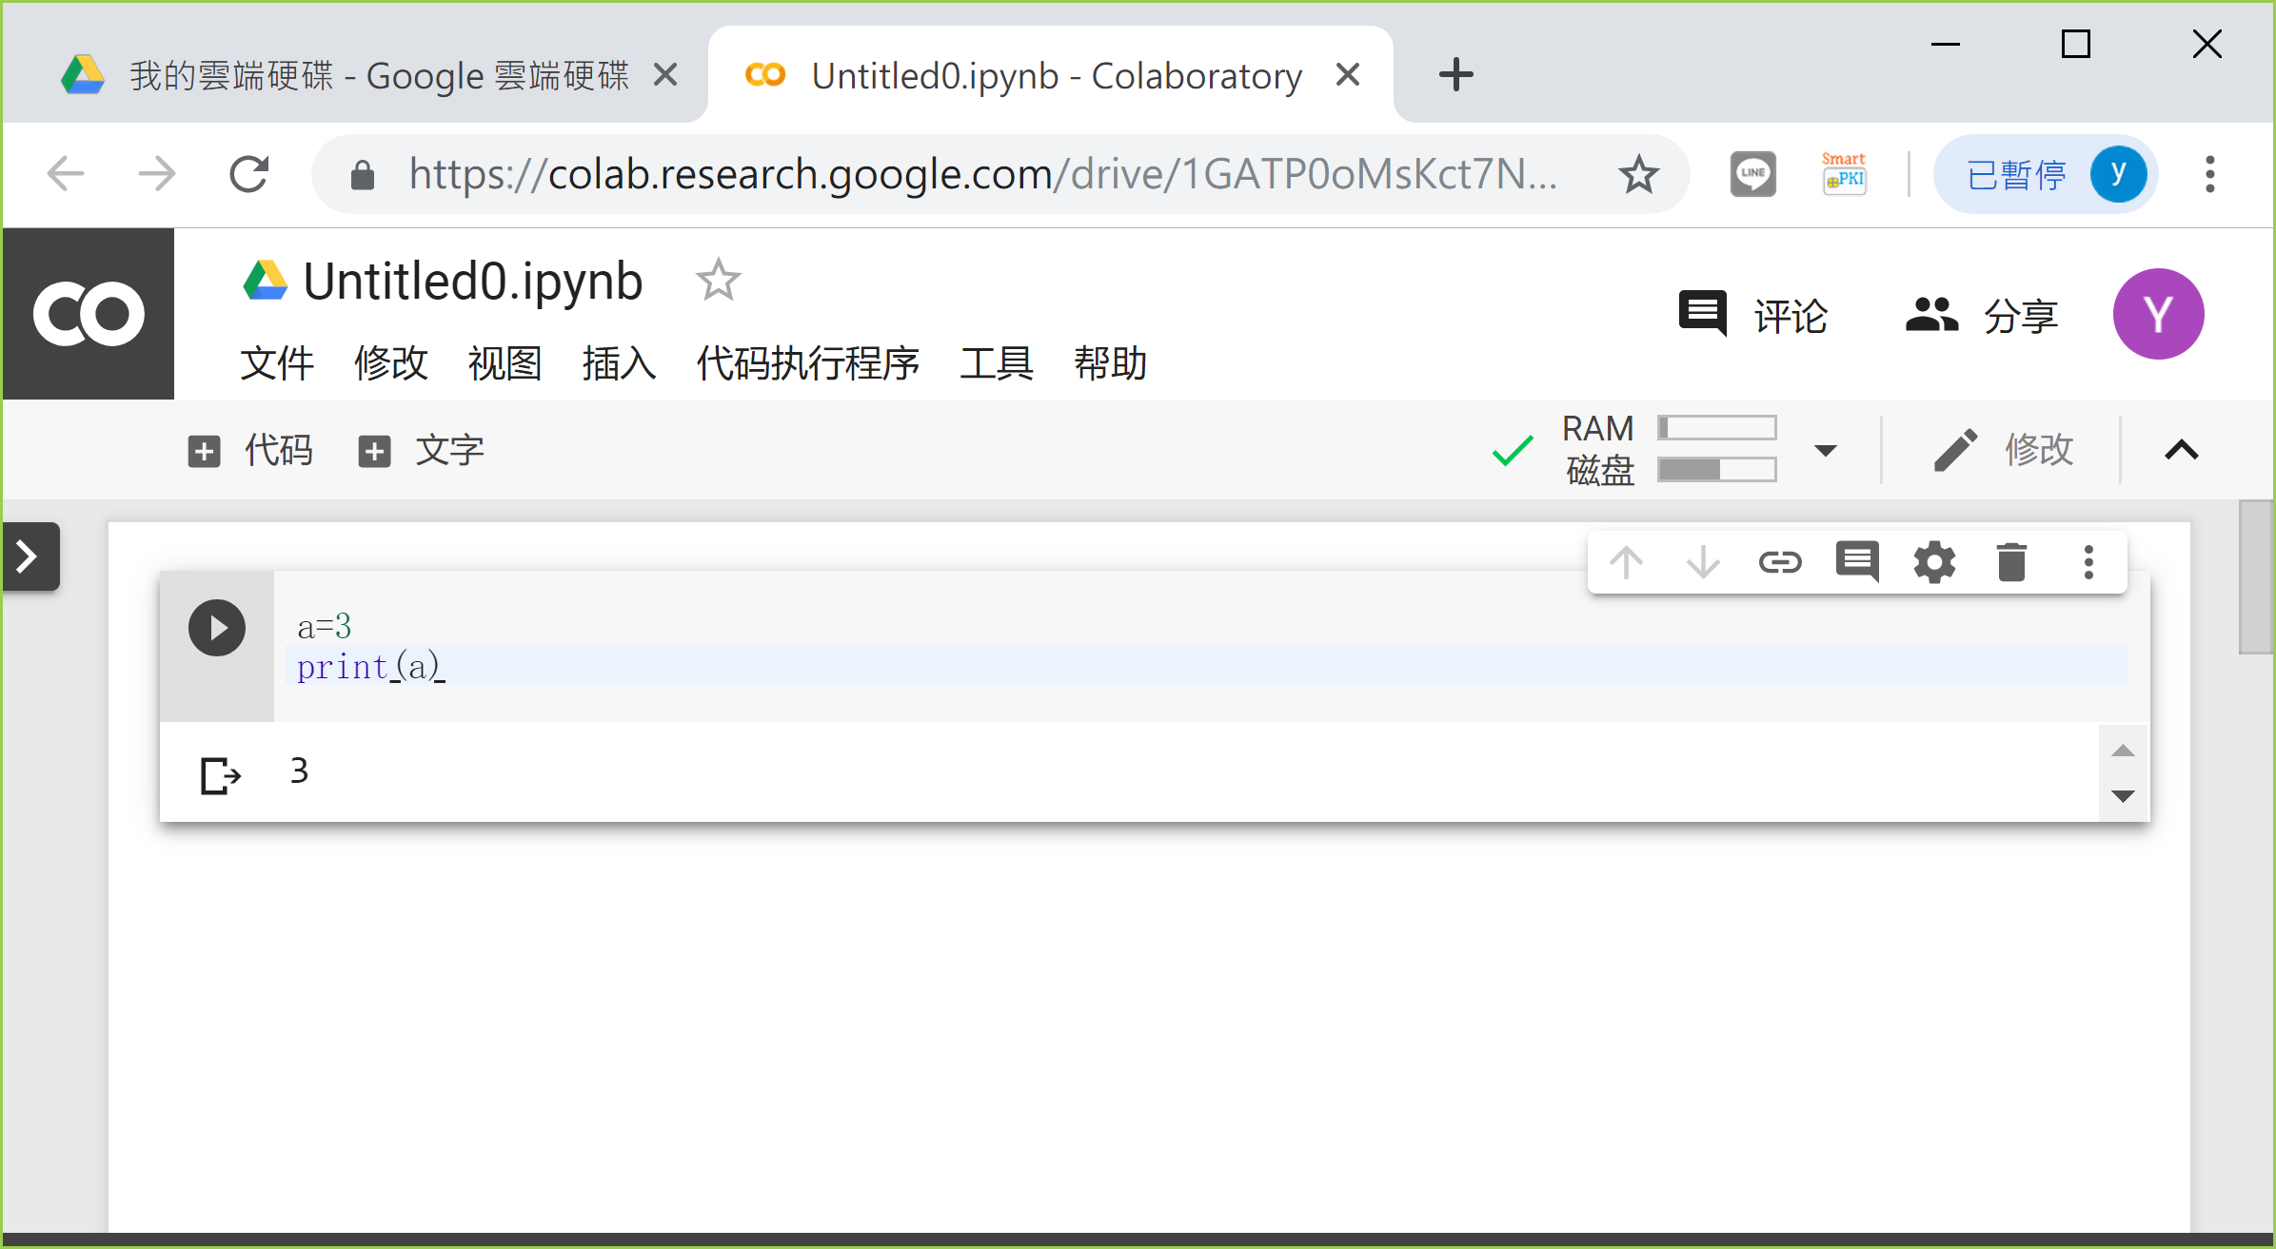
Google Colaboratory
Google Drive/Colab Notebooks
Control+Enter

Slide 23
練習
第一次開啟Colab檔案
選取GPU作為運算單元
上傳/下載檔案
開啟權限
上傳/下載至Google Drive
從GitHub下載
安裝package

Slide 24
機器學習簡介

Slide 25
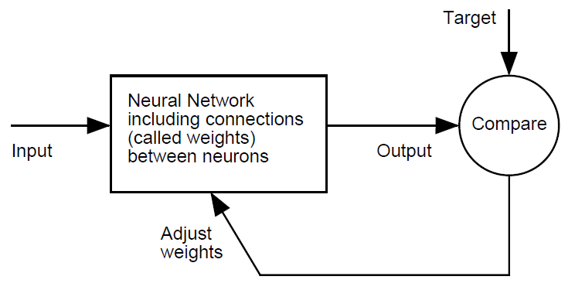
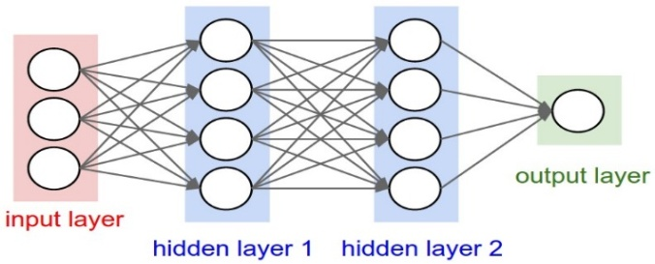
Supervised Learning
y=ax+b=1.2x+0.5
Model
Parameters of Model
Parameters of Learning
Learning algorithm
Object function
d
x

Slide 26
Model Diagnostic
x₂
d
x₁
x
x₂
x₂
x₁
x₁

Slide 27
Supervised Learning
In supervised learning, we have a dataset consisting of both features (input variables) and labels (output variables)
The task is to construct an estimator(model) which enables to predict the labels of an instance given the set of features
Two categories: Classification and Regression
Classification: the label is discrete
Regression: the label is continuous
Split into training and testing datasets

Slide 28
開源的資料集簡介

Slide 29
Datasets
UCI Machine Learning Repository
Kaggle
MNIST
ImageNet
CIFAR-10/100
MS-COCO
Pascal VOC
AIdea

Slide 30
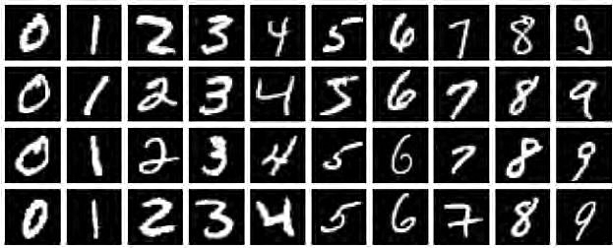
MNIST
handwritten digits
手寫數字分類
http://yann.lecun.com/exdb/mnist/index.html

Slide 31
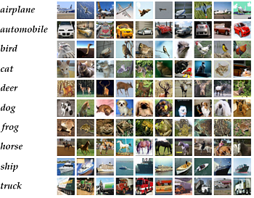
CIFAR-10/100
32×32 natural image dataset with 10/100 categories
影像分類
http://www.cs.toronto.edu/~kriz/cifar.html

Slide 32
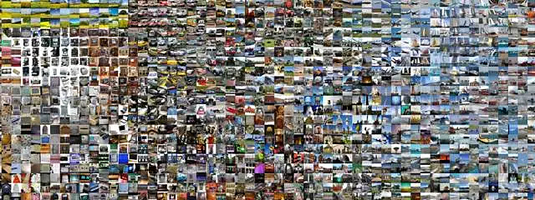
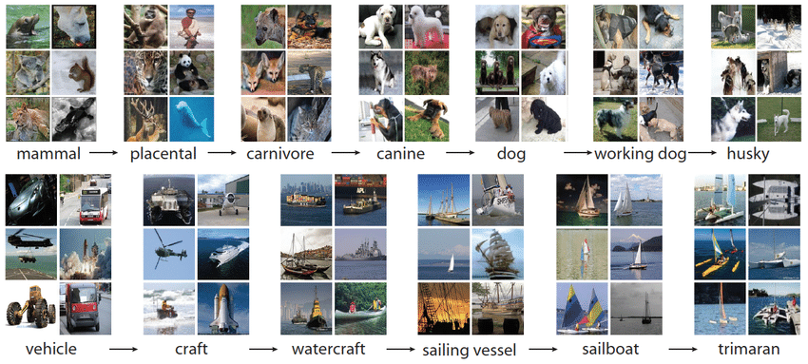
ImageNet
影像分類
http://www.image-net.org/about-stats

Slide 33
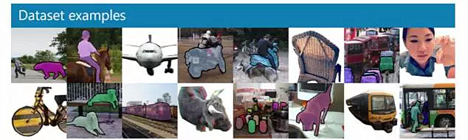
MS-COCO
影像分類、影像定位、影像分割
Common Objects in Context

Slide 34
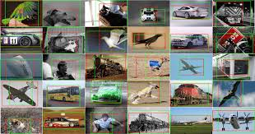
Pascal VOC
影像分類、影像定位、影像分割

Slide 35

Kaggle
https://www.kaggle.com/datasets

Slide 36
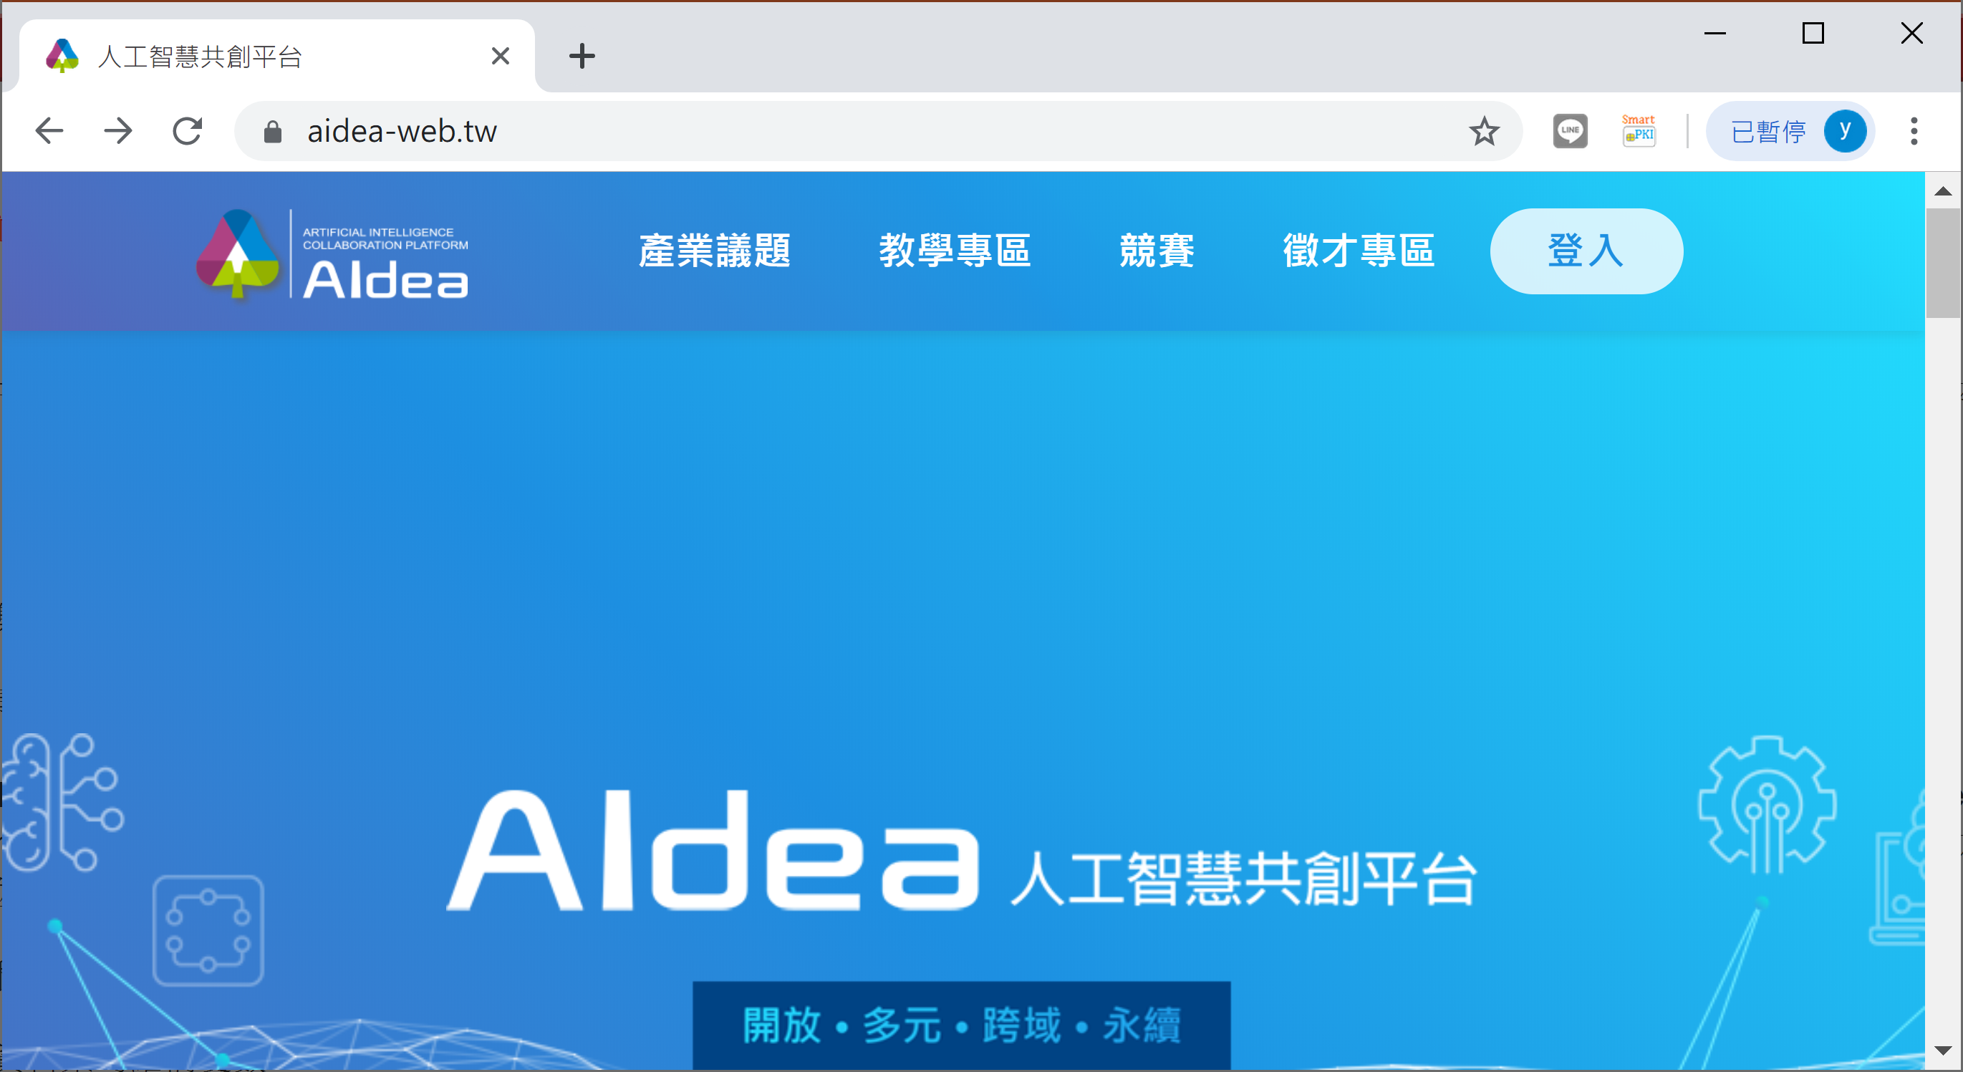
Aidea 人工智慧共創平台
https://aidea-web.tw/

Slide 37
機器學習問題

Slide 38
Learning Problem
影像/數值
Text
Numerical
Images
Text
Numerical
Images
Neural Networks
(Deep Learning)

Slide 39
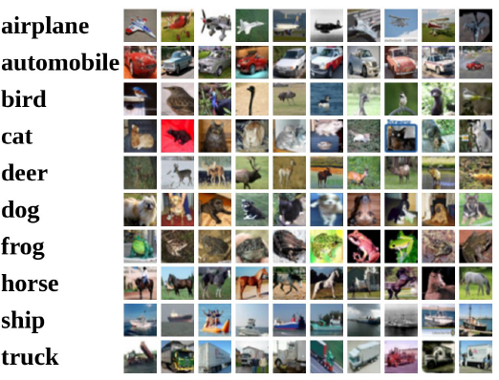
影像分類的目的
標籤值

Slide 40
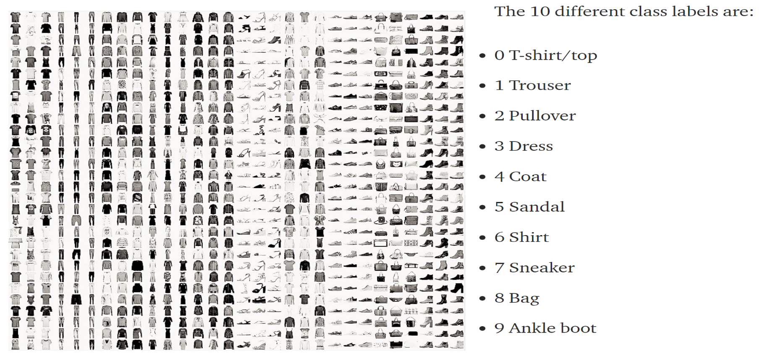
影像分類的目的
Fashion MNIST Dataset
https://towardsdatascience.com/the-4-convolutional-neural-network-models-that-can-classify-your-fashion-images-9fe7f3e5399d

Slide 41
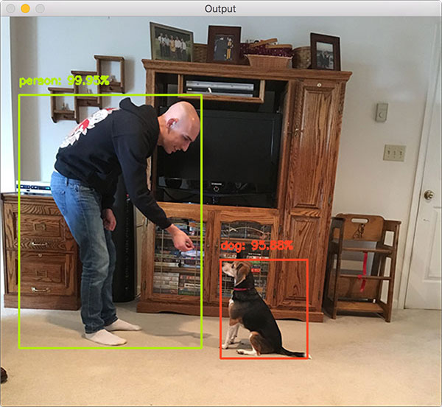
物件偵測的目的
偵測物件邊界框位置 (x, y, w, h) 的4個參數
圖片來源: https://www.pyimagesearch.com/2017/09/11/object-detection-with-deep-learning-and-opencv/

Slide 42
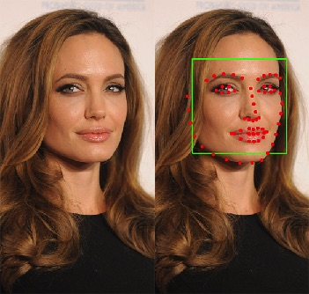
臉部特徵點的目的
偵測臉部68個關鍵點座標位置
資料來源: https://juanzdev.github.io/TeethClassifier/
Notes:
https://juanzdev.github.io/TeethClassifier/

Slide 43
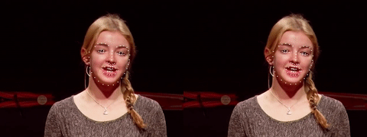
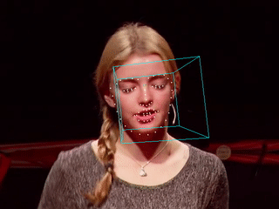

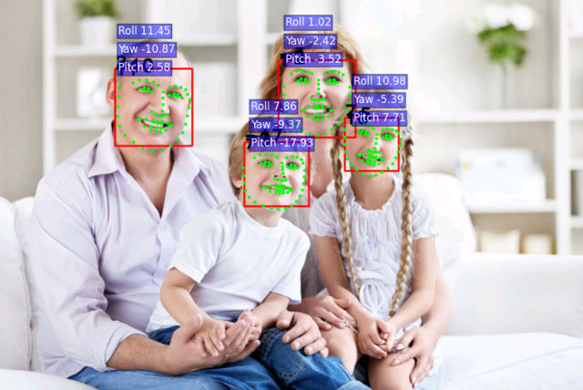
臉部特徵點的目的
資料來源: https://github.com/yinguobing/cnn-facial-landmark

Slide 44
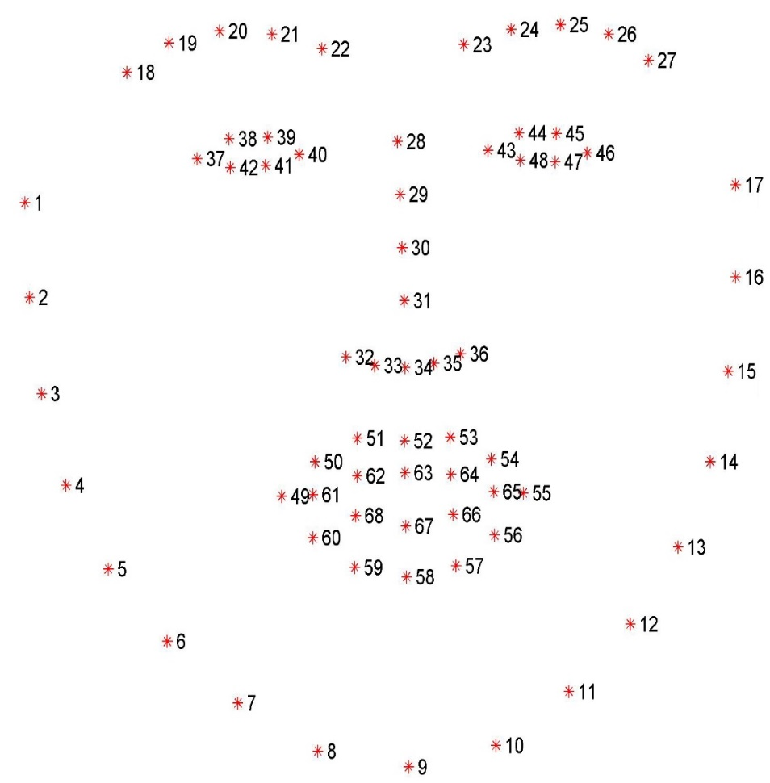
臉部特徵點的目的
68 points

Slide 45
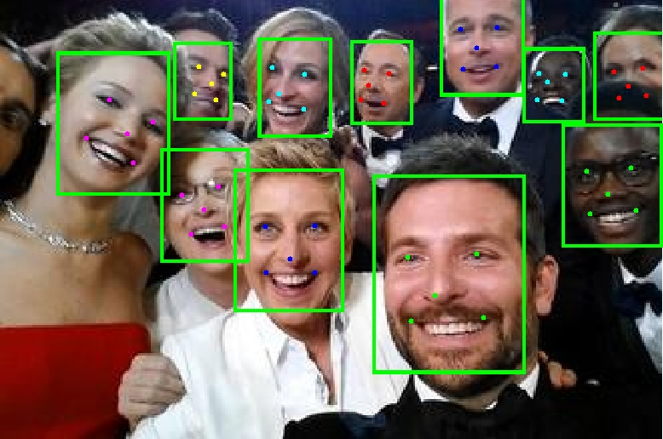
臉部識別的目的
Multi-task Cascaded Convolutional Networks
https://www.youtube.com/watch?v=zZZcEu-iZnk
Notes:
https://www.youtube.com/watch?v=zZZcEu-iZnk 三个臭皮匠，顶个诸葛亮 || 5分钟看懂CV顶刊论文 https://zhuanlan.zhihu.com/p/59262113
小模型P-Net快速排除图片中不含人脸的部分。
中模型R-Net进一步排除不含人脸的部分，并估计含有人脸框的位置
大模型O-Net敲定人脸的位置，重叠的框用NMS除去并且标记人脸的左右眼、鼻、两嘴角共5个位置。

Slide 46
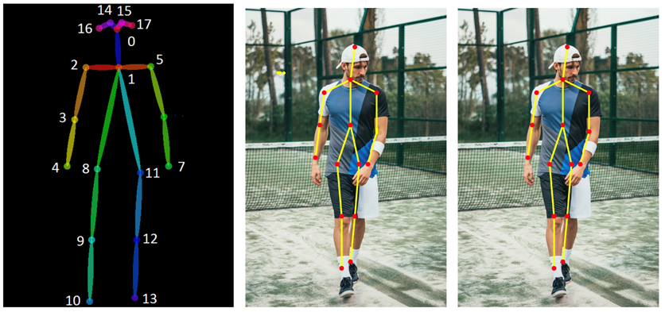
人體骨架偵測的目的
人體骨架偵測
圖片來源: https://blog.nanonets.com/human-pose-estimation-2d-guide/

Slide 47
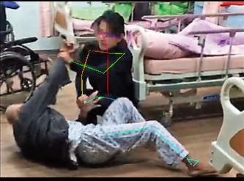
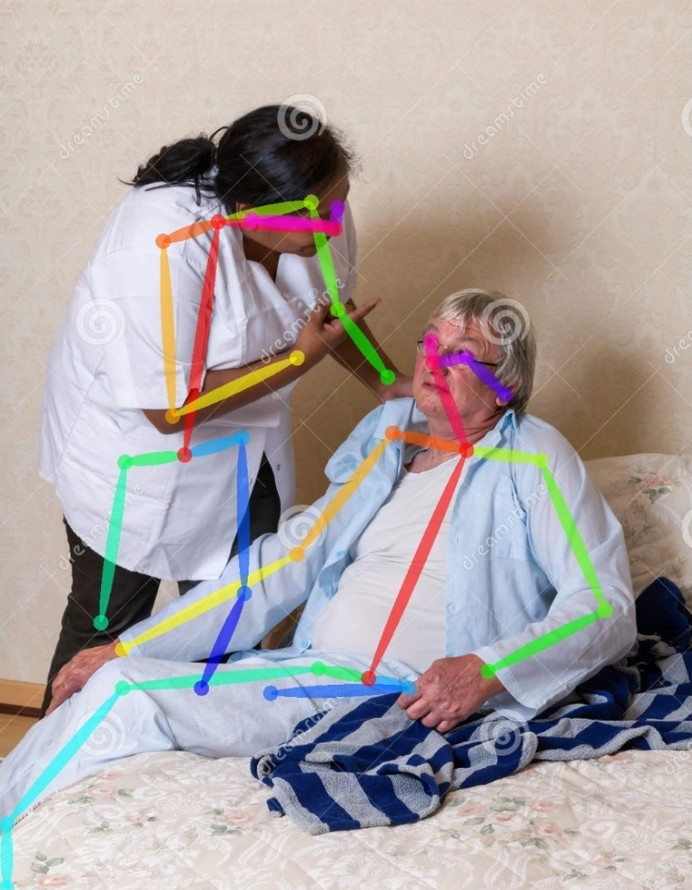
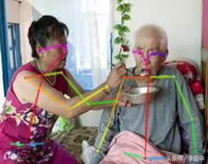
人體骨架偵測
找到肢體的18個關鍵點座標位置

Slide 48
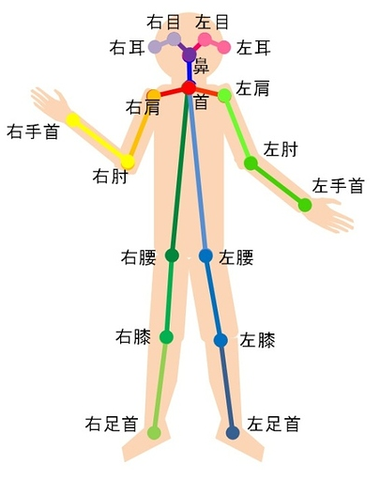
15 or 18 points
Realtime Multi-Person 2D Pose Estimation using Part Affinity Fields
Notes:
https://bigquant.com/community/t/topic/113429

Slide 49
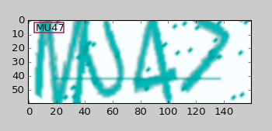
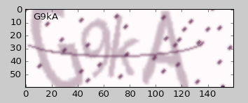
Question & Answer
數字分類

Slide 50
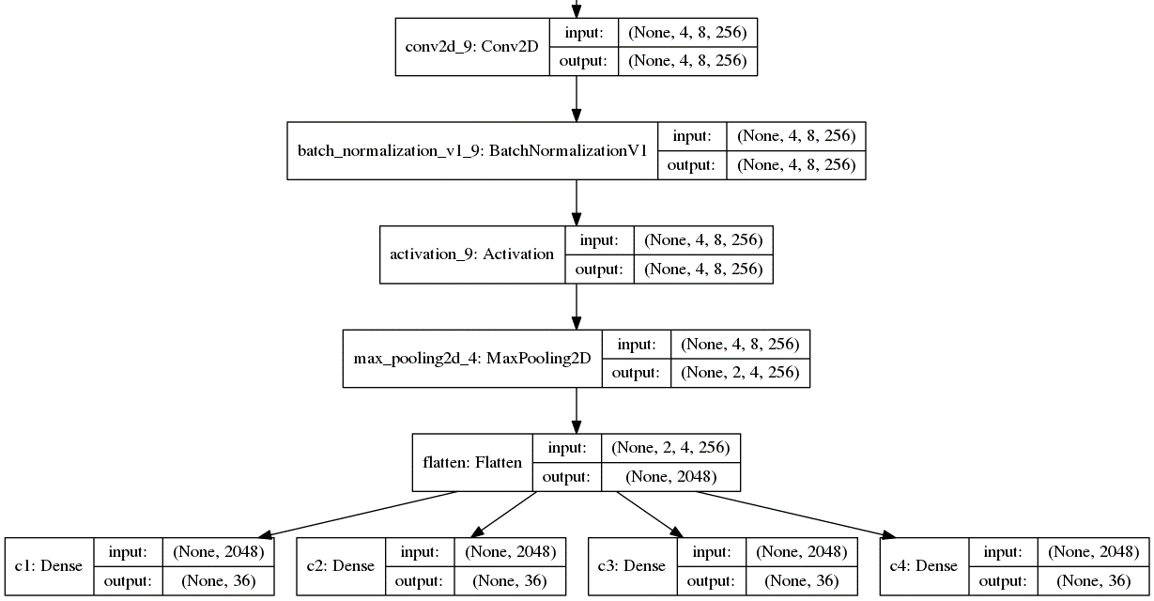
驗證碼的目的
https://github.com/ypwhs/captcha_break

Slide 51
Learning Problem
Text
Numerical
Images
Text
Numerical
Images
Neural Networks
(Deep Learning)

Slide 52
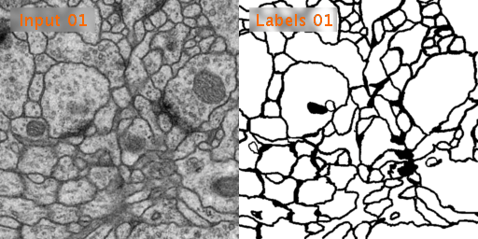
影像分割的目的
Image Segmentation
像素點的標籤或索引值 (index)
U-Net: Convolutional Networks for Biomedical Image Segmentation.

Slide 53
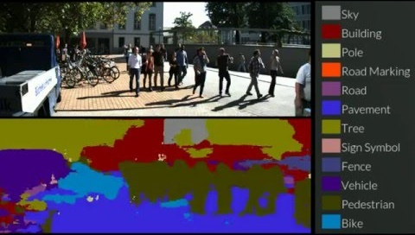
語意分割的目的
Semantic segmentation: pixel-based
Source: A Deep Convolutional Encoder-Decoder Architecture for multi-class pixelwise segmentation (Semantic Segmentation using Deep Learning)

Slide 54
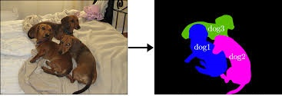
實體分割的目的
Instance Segmentation
http://publications.lib.chalmers.se/records/fulltext/250417/250417.pdf
Notes:
http://publications.lib.chalmers.se/records/fulltext/250417/250417.pdf

Slide 55
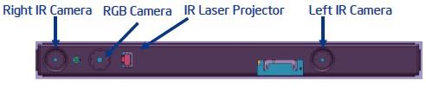
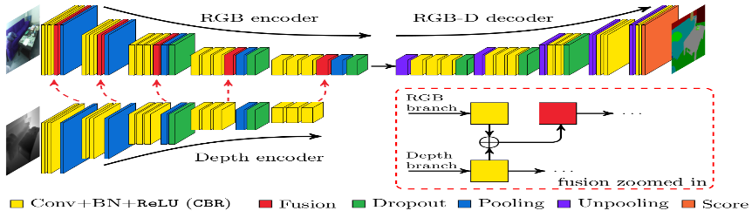
Depth Estimation
FuseNet: Incorporating Depth into Semantic Segmentation via Fusion-based CNN Architecture
Notes:
http://hazirbas.com/projects/fusenet/

Slide 56



Depth Estimation
FuseNet: Incorporating Depth into Semantic Segmentation via Fusion-based CNN Architecture
Notes:
FuseNet: Incorporating Depth into Semantic Segmentation via Fusion-based CNN Architecture

Slide 57

Inpainting & Denoising
"Deep Image Prior": super-resolution, inpainting, denoising without learning on a dataset and pretrained networks.

Slide 58
Learning Problem
數值/數值
Text
Numerical
Images
Text
Numerical
Images
Neural Networks
(Deep Learning)

Slide 59



飯前血糖預測
飯前血糖預測
飯前血糖預測

Slide 60
Question & Answer
Lotto Problem
Numerical
Neural Networks
(Deep Learning)
Numerical

Slide 61
Model Problem
文字/數字
Text
Numerical
Images
Text
Numerical
Images
Neural Networks
(Deep Learning)

Slide 62
骨折病例文字探勘
1096 T-L Spine: AP+Lat * Degenerative change of lumbar and visible lower thoracic spine with spurring. * Mild anterolisthesis of L3 on L4 and mild retrolisthesis of L4 on L5 vertebra. * Narrowing of T11-12, L3-4, L4-5, L5-S1 intervertebral disc space. * Collapse of T12 vertebra status post vertebroplasty. * New compression fracture of T11 vertebra. * Calcification of abdominal aorta. * Decreased density of bone, suspect osteoporosis.
脊椎骨折
yes(1) or no(0)
1096 T-L Spine: AP+Lat * Degenerative change of lumbar and visible lower thoracic spine with spurring. * Mild anterolisthesis of L3 on L4 and mild retrolisthesis of L4 on L5 vertebra. * Narrowing of T11-12, L3-4, L4-5, L5-S1 intervertebral disc space. * Collapse of T12 vertebra status post vertebroplasty. * New compression fracture of T11 vertebra. * Calcification of abdominal aorta. * Decreased density of bone, suspect osteoporosis.
+
=
脊椎骨折
Probability(0.97)

Slide 63
Learning Problem
數值對影像
Text
Numerical
Images
Text
Numerical
Images
Neural Networks
(Deep Learning)

Slide 64

GAN Concept
Introduced by Ian Goodfellow in 2014
Packt, Advanced Deep Learning with Keras

Slide 65

GAN Concept
數值對影像

Slide 66

Discriminator Training
Packt, Advanced Deep Learning with Keras

Slide 67

Generator Training
Packt, Advanced Deep Learning with Keras

Slide 68

DCGAN
Deep + Convolutional
Transposed Convolution Operation (Deconvolution Layer)
http://www.hackcha.cn/?p=360

Slide 69

Conditional GAN

Slide 70

Image to Image Pix2Pix
Isola et al., Image-to-Image Translation with Conditional Adversarial Nets, 2016.

Slide 71

Super Resolution
Source: Photo-Realistic Single Image Super-Resolution Using a Generative Adversarial Network, (Zhu et al., 2016)

Slide 72

Deep Fake
https://twitter.com/i/status/986257991799222272

Slide 73

Deep Nude
DeepNude
https://www.moonlol.com/deepnude-app-6311.html

Slide 74
線上機器學習範例介紹
Notes:
https://leemeng.tw/deep-learning-resources.html

Slide 75

Neural Network
Linearly Problem
https://playground.tensorflow.org/

Slide 76

Neural Network demo
Nonlinear model
https://lecture-demo.ira.uka.de/neural-network-demo/

Slide 77

Neural Network
Nonlinear model

Slide 78

Teachable Machine
https://teachablemachine.withgoogle.com/

Slide 79
特徵映射

Slide 80

Simple NN vs. DL
https://towardsdatascience.com/parallel-and-distributed-deep-learning-a-survey-97137ff94e4c

Slide 81


Feature Extraction

Slide 82

Simple NN
Car: “1”
No Car: “0”

Slide 83
Deep Learning
Car: “1”
No Car: “0”

Slide 84
Feature Map
Matrix
Mapping
Nonlinear
Connected
Dropout
Normalization
…
Y=AX
X: R⁴
Y: R²

Slide 85

Feature Map
X: R⁴
Y: R¹
Node
Sallow Neural Network

Slide 86

Deep Feature Map
深度學習模型 (Model)

Slide 87
醫學專題實作

Slide 88
UCI Breast Cancer
Associated tasks: Classification
Number of instances: 569
Number of attributes: 30 (mean, standard error, worst)
id
radius
texture
perimeter
area
smoothness
compactness
concavity
concave points
symmetry
fractal dimension
(10 different characteristics of the digitized cell nuclei)
Class: B(benign)/M(malignant)

Slide 89

Breast Cancer
https://www.kaggle.com/buddhiniw/breast-cancer-prediction

Slide 90

Heart Disease
https://www.kaggle.com/serhatmazlum/analyzing-heart-disease-s-dataset

Slide 91

Cervical Cancer Risk
https://www.kaggle.com/loveall/cervical-cancer-risk-classification

Slide 92

Survival Data Set
https://www.kaggle.com/gilsousa/habermans-survival-data-set

Slide 93

Diabetes Database
https://www.kaggle.com/buddhiniw/breast-cancer-prediction

Slide 94

課後提問
快問快答

Slide 95

課後練習一
使用Colab載入GitHub資料集

Slide 96
評分標準
平時 50%
點名
課後提問
作業練習
期末實作 50%

Slide 97
專題實作
分類
回歸
分群
降低維度
醫學範例實作

